Slide 1
Software Engineering Practice Week 6

Slide 2
Project Plan –Tutoring 3
week | Iteration | Start Date | End Date | Release
Week 4 | Iteration 0 | 13/08/2018 | 19/08/2018 | 1
Week 5 | Iteration 1 | 20/08/2018 | 27/08/2018 | 1
Week 6 | Iteration 2 | 27/08/2018 | 2/09/2018 | 1
Week 7 | Iteration 3 | 3/09/2018 | 9/09/2018 | 1
week | Iteration | Start Date | End Date | Release
Week 8 | Iteration 1 | 10/09/2018 | 16/09/2018 | 2
Week 9 | Iteration 2 | 17/09/2018 | 23/09/2018 | 2
Week 10 | Iteration 3 | 24/09/2018 | 2/10/2018 | 2
Week 11 | Iteration 4 | 3/10/2018 | 9/10/2018 | 2
Week 12 | Iteration 5 | 10/10/2018 | 17/10/2018 | 2
Assignment 1
Show Case
Assignment 2
Show Case

Slide 3
week | Iteration | Start Date | End Date | Release
Week 4 | Iteration 0 | 13/08/2018 | 19/08/2018 | 1
Week 5 | Iteration 1 | 20/08/2018 | 27/08/2018 | 1
Week 6 | Iteration 2 | 27/08/2018 | 2/09/2018 | 1
Week 7 | Iteration 3 | 3/09/2018 | 9/09/2018 | 1
week | Iteration | Start Date | End Date | Release
Week 8 | Iteration 1 | 10/09/2018 | 16/09/2018 | 2
Week 9 | Iteration 2 | 17/09/2018 | 23/09/2018 | 2
Week 10 | Iteration 3 | 24/09/2018 | 2/10/2018 | 2
Week 11 | Iteration 4 | 3/10/2018 | 9/10/2018 | 2
Week 12 | Iteration 5 | 10/10/2018 | 17/10/2018 | 2
week | Sprint | Start Date | End Date
Week 8 | Sprint 1 | 12/09/2018 | 19/09/2018
Week 9 |  | 19/09/2018 | 25/09/2018
Week 10 | Sprint 2 | 26/09/2018 | 4/10/2018
Week 11 |  | 5/10/2018 | 11/10/2018
Week 12 | Show Case | 12/10/2018

Slide 4


References

Slide 5
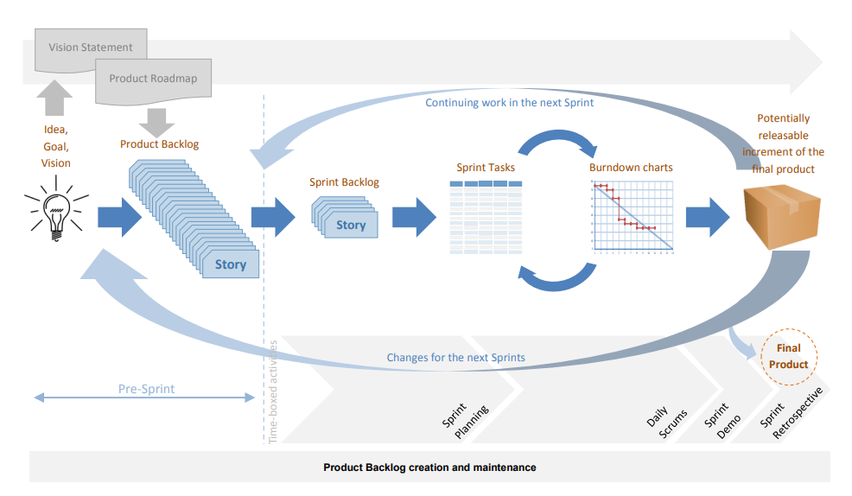

Slide 6
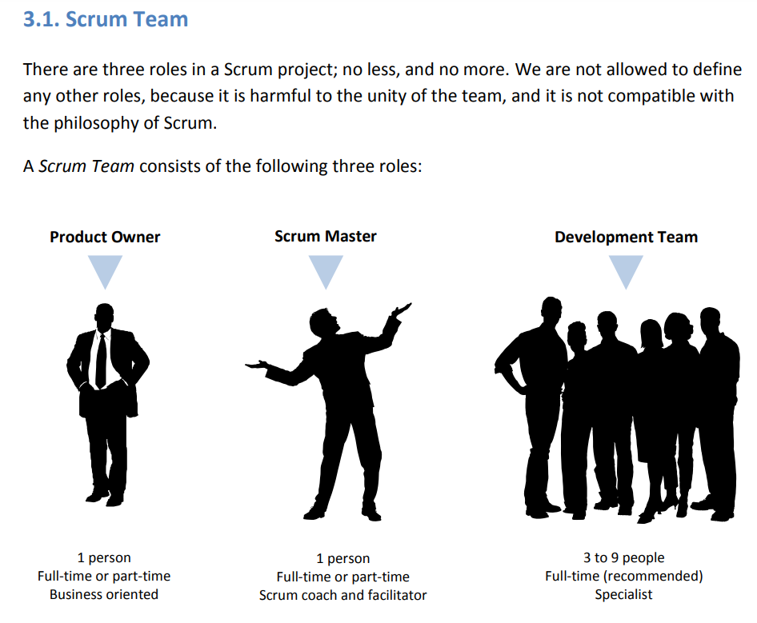

Slide 7
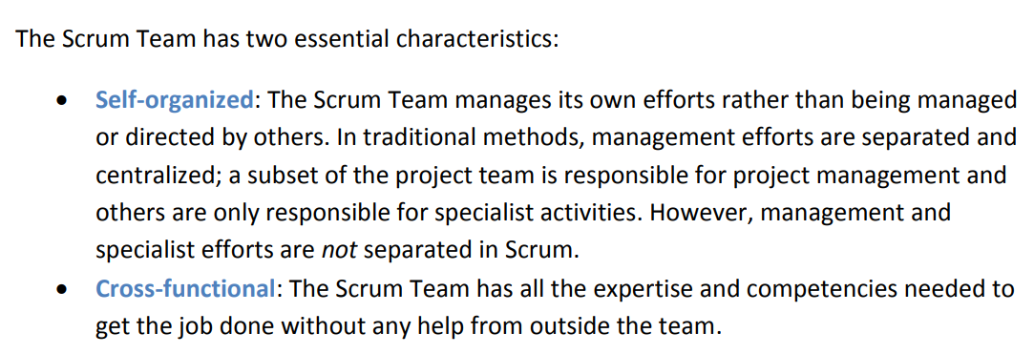

Slide 8
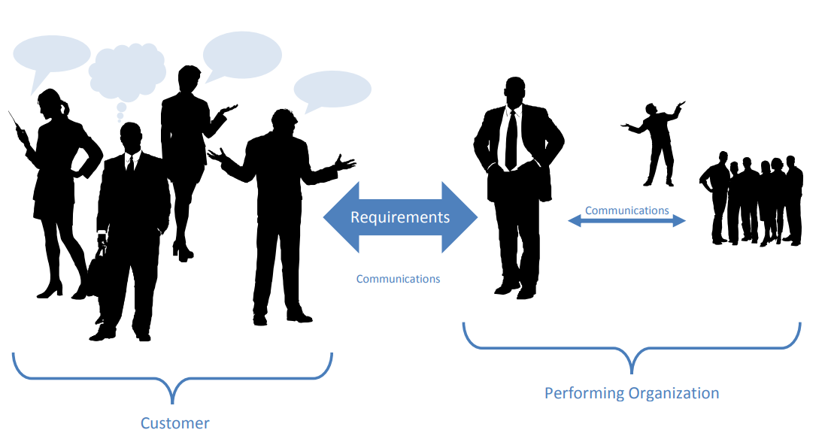

Slide 9
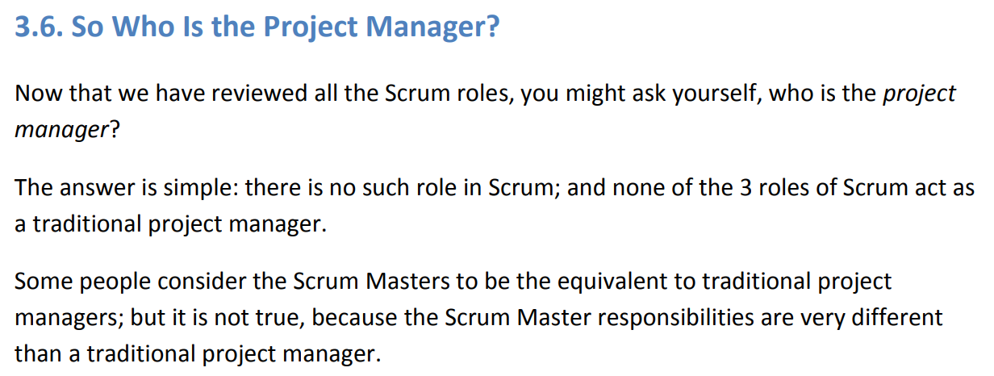

Slide 10
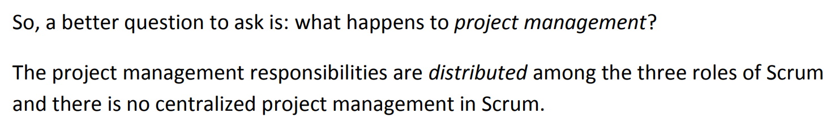

Slide 11
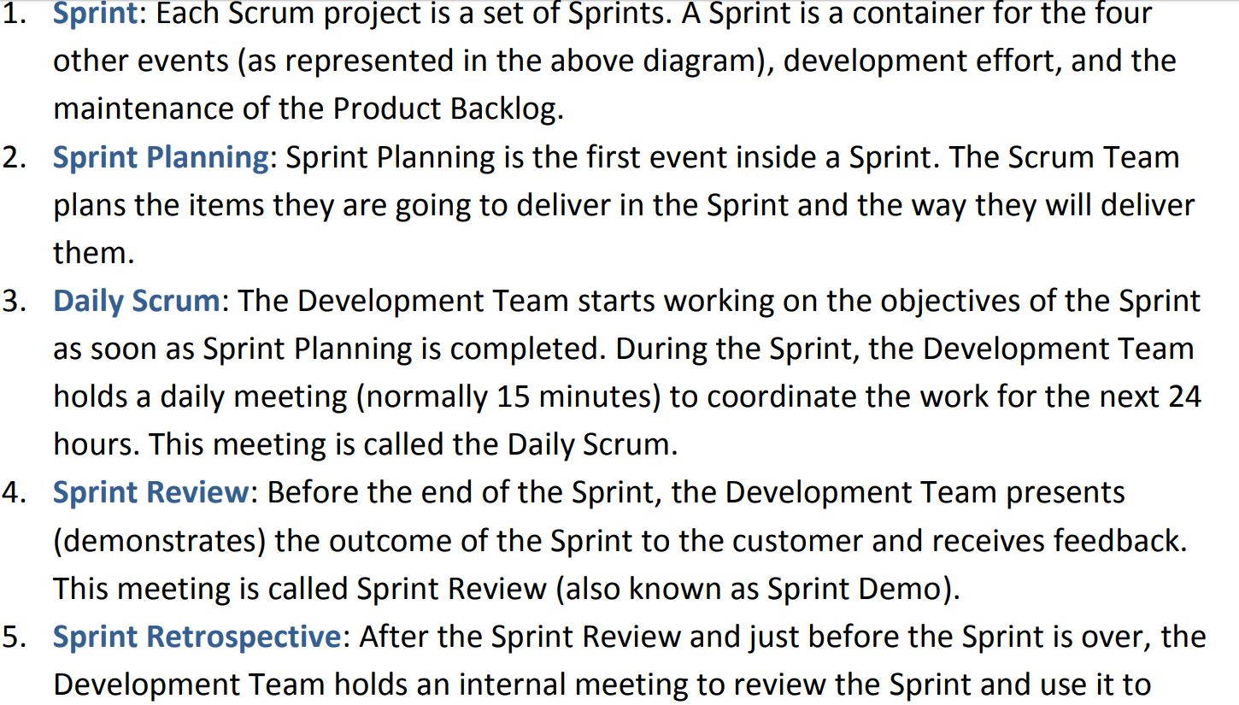

Slide 12
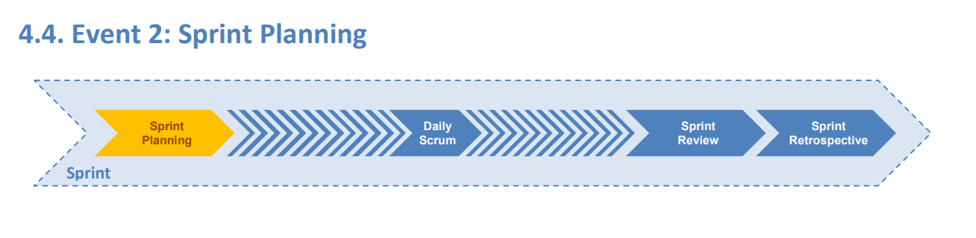
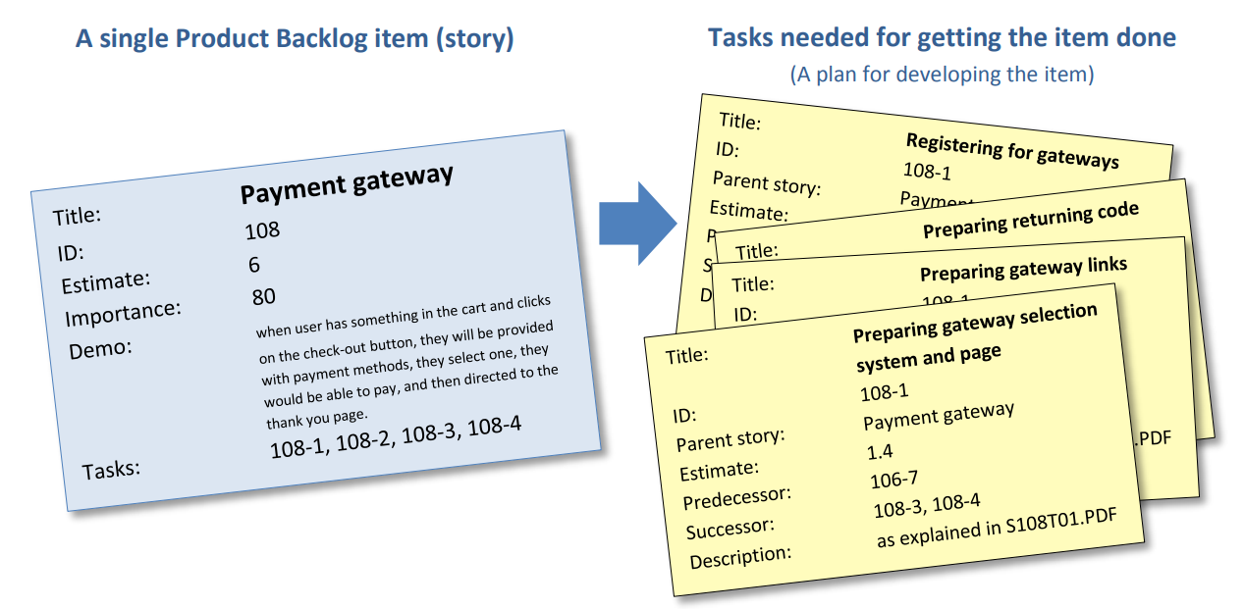

Slide 13
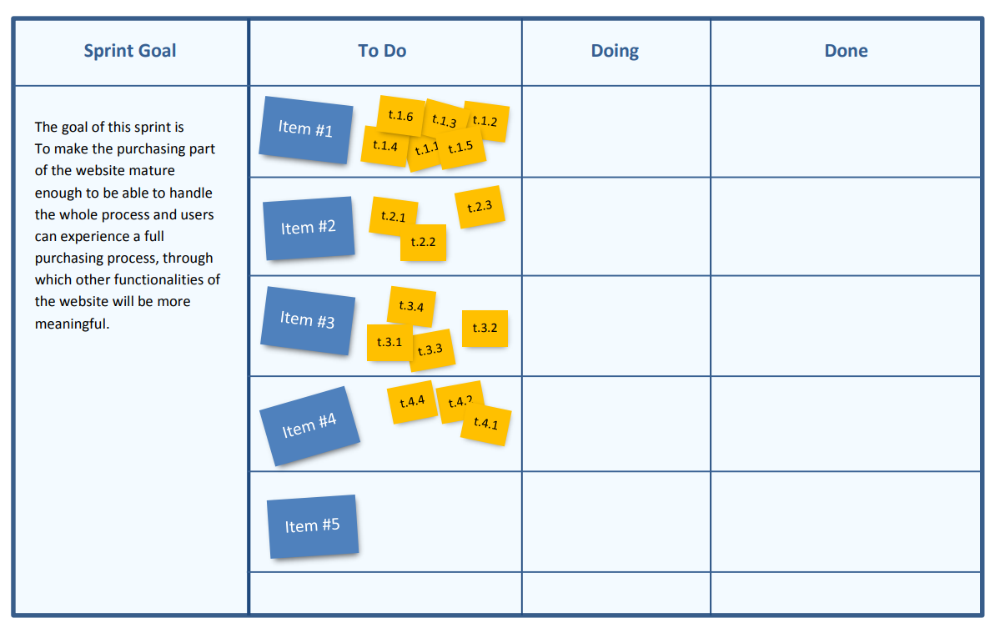

Slide 14
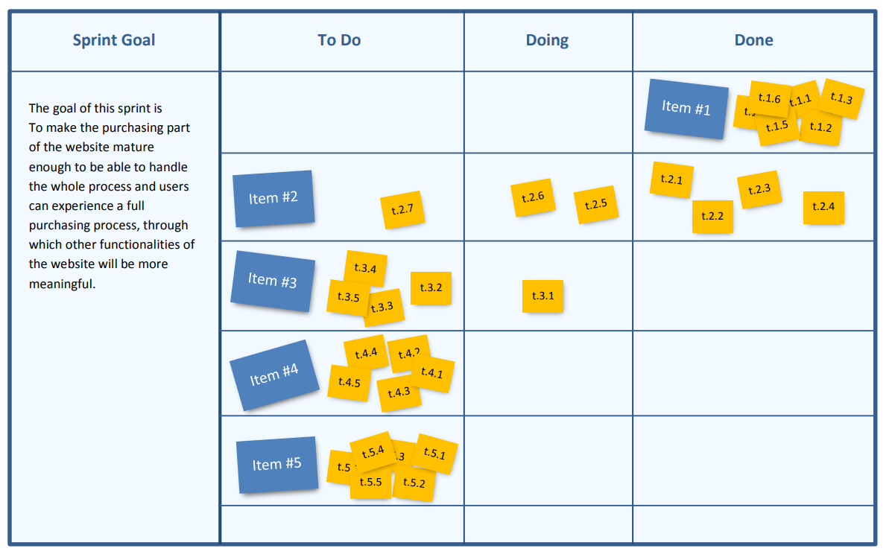

Slide 15
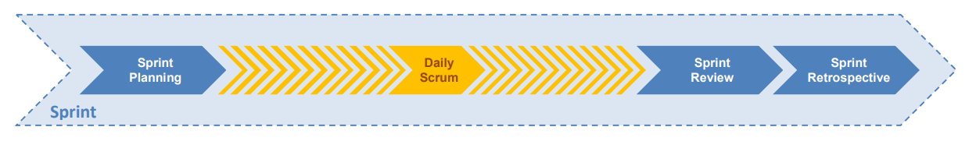
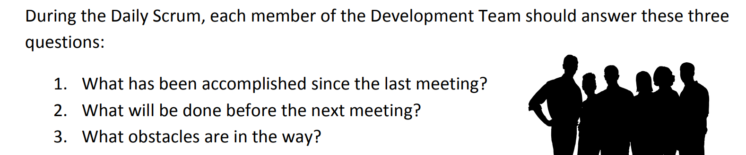

Slide 16
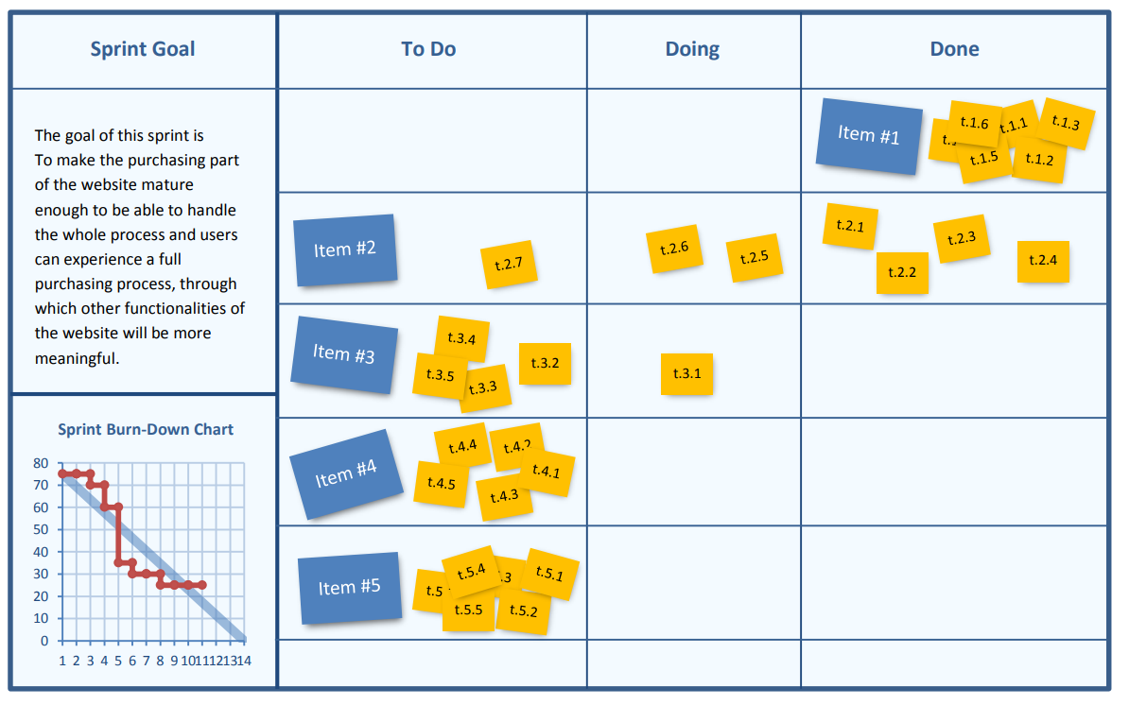

Slide 17
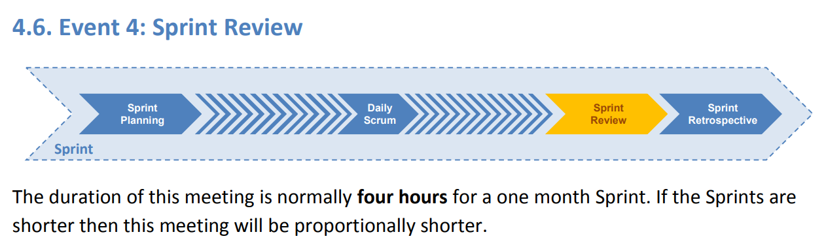

Slide 18
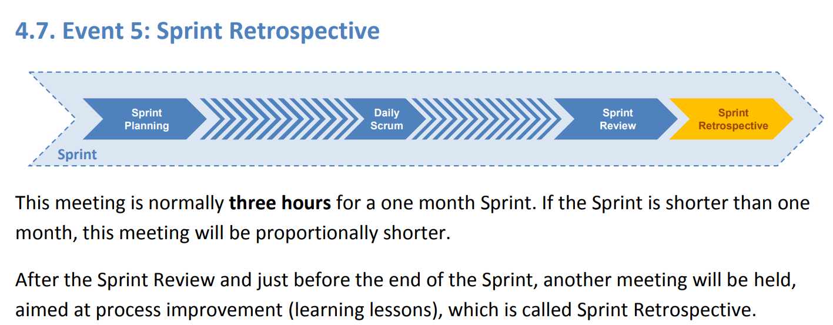

Slide 19
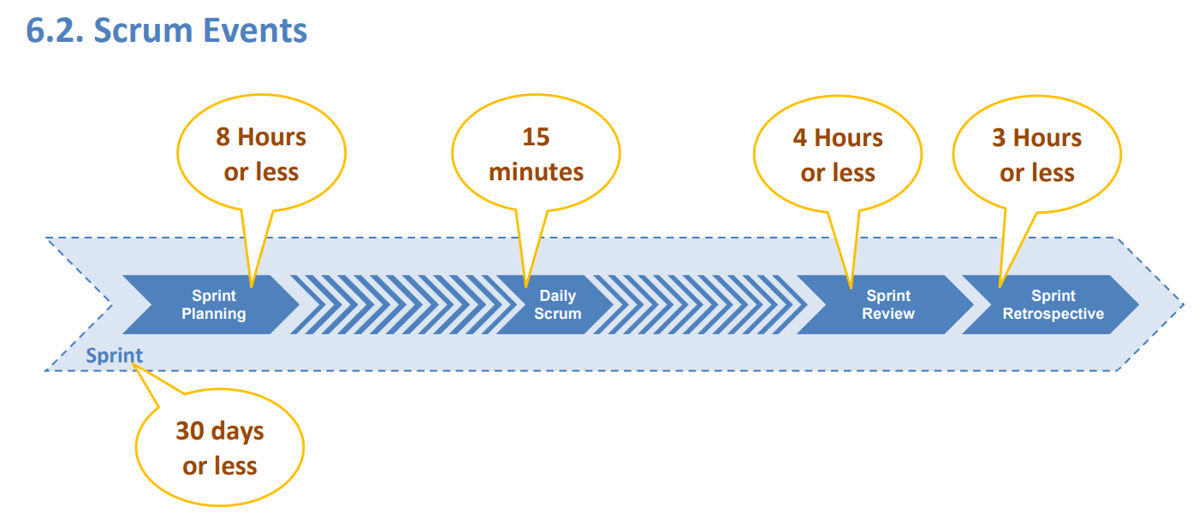

Slide 20
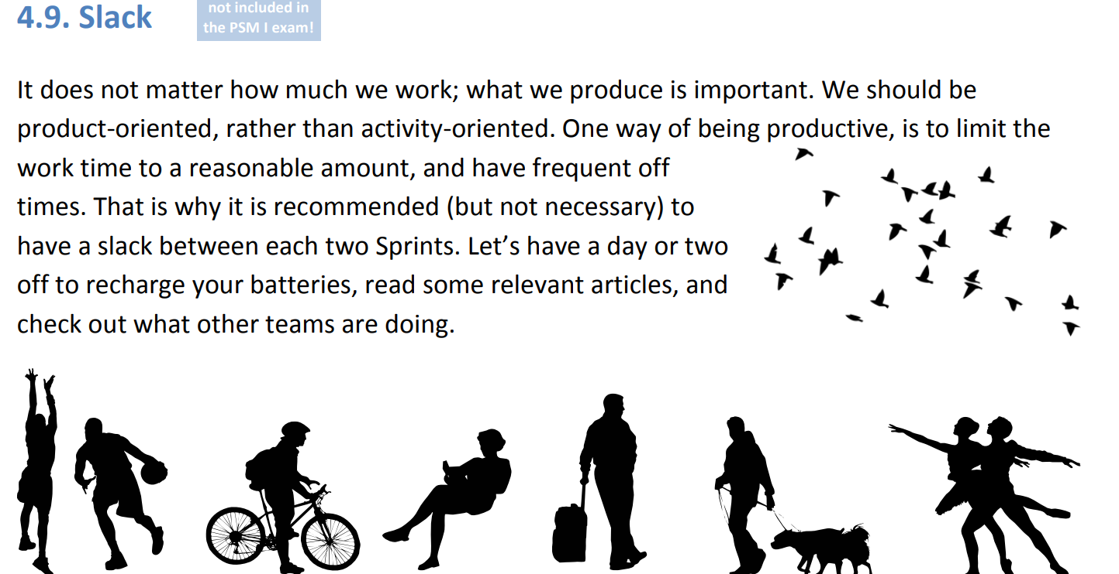

Slide 21
week | Iteration | Start Date | End Date | Release
Week 4 | Iteration 0 | 13/08/2018 | 19/08/2018 | 1
Week 5 | Iteration 1 | 20/08/2018 | 27/08/2018 | 1
Week 6 | Iteration 2 | 27/08/2018 | 2/09/2018 | 1
Week 7 | Iteration 3 | 3/09/2018 | 9/09/2018 | 1
week | Iteration | Start Date | End Date | Release
Week 8 | Iteration 1 | 10/09/2018 | 16/09/2018 | 2
Week 9 | Iteration 2 | 17/09/2018 | 23/09/2018 | 2
Week 10 | Iteration 3 | 24/09/2018 | 2/10/2018 | 2
Week 11 | Iteration 4 | 3/10/2018 | 9/10/2018 | 2
Week 12 | Iteration 5 | 10/10/2018 | 17/10/2018 | 2
week | Sprint | Start Date | End Date
Week 8 | Sprint 1 | 12/09/2018 | 19/09/2018
Week 9 |  | 19/09/2018 | 25/09/2018
Week 10 | Sprint 2 | 26/09/2018 | 4/10/2018
Week 11 |  | 5/10/2018 | 11/10/2018
Week 12 | Show Case | 12/10/2018

Slide 22
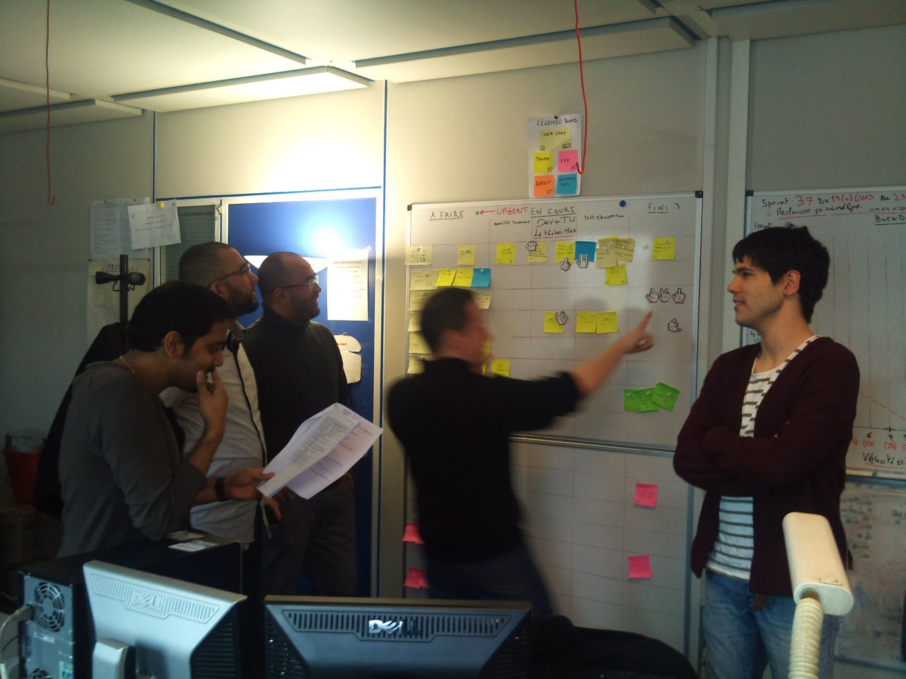
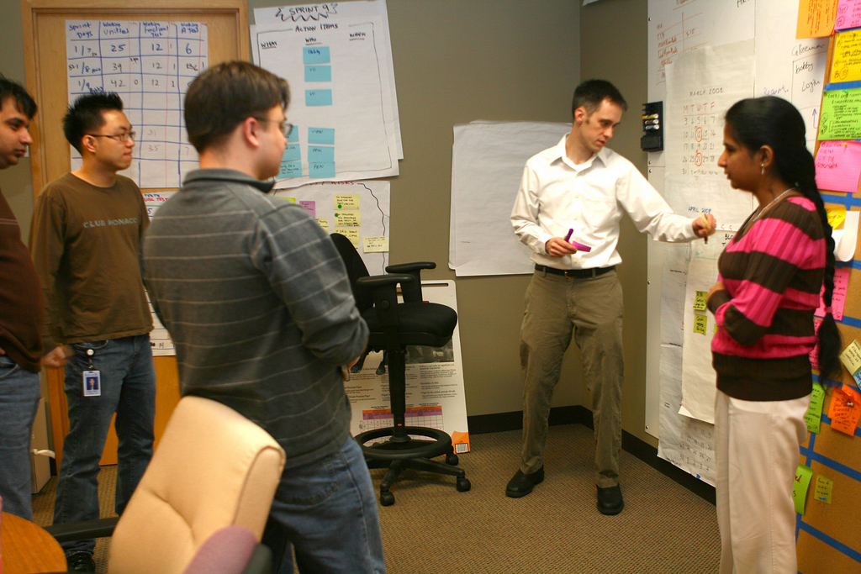
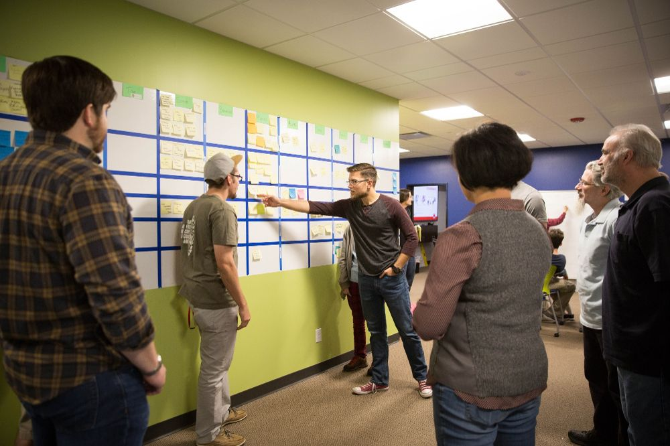
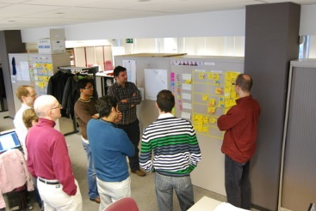

Slide 23

Dev Ops

Slide 24
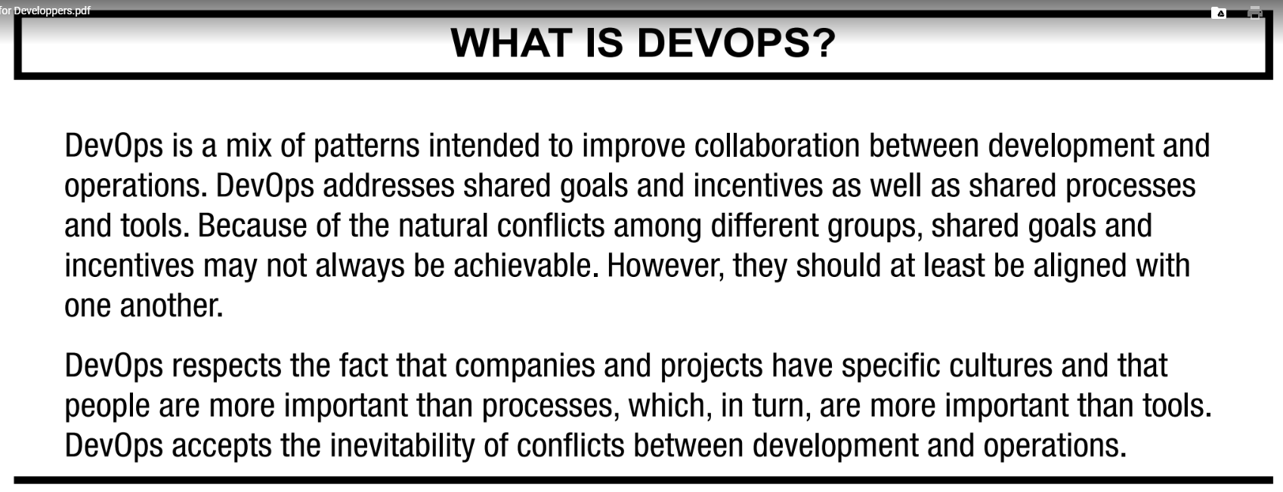

Slide 25
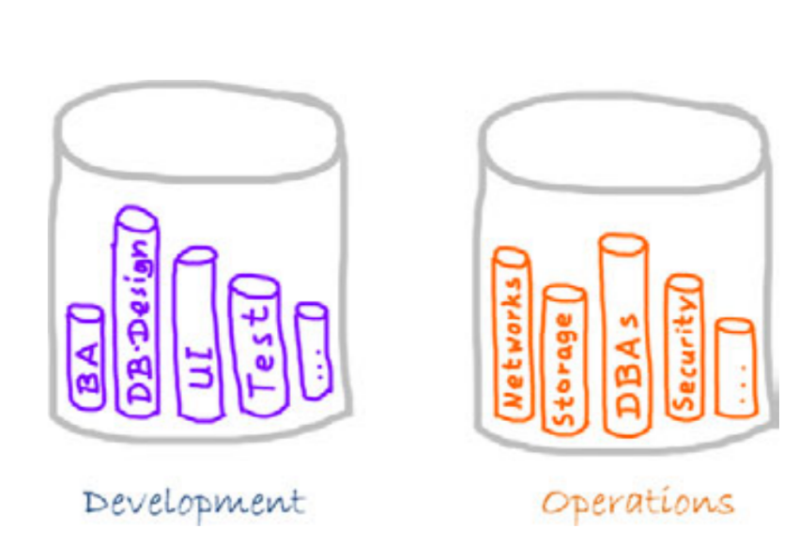
Dev. Ops : blend the operations between development and Operations

Slide 26
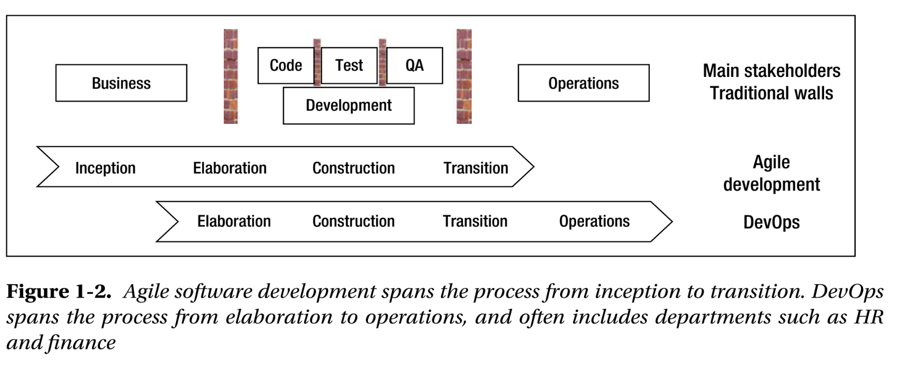

Slide 27
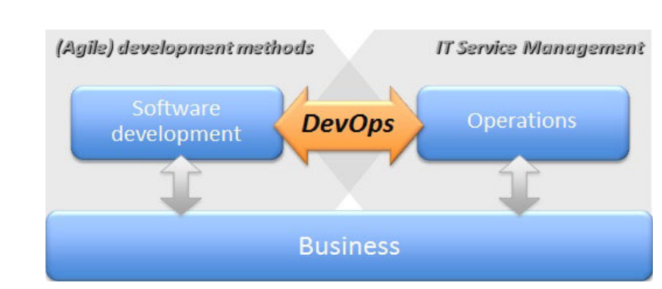

Slide 28
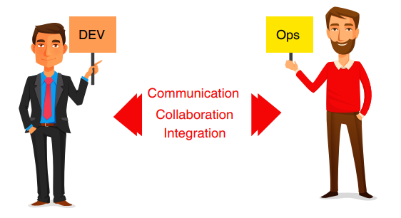
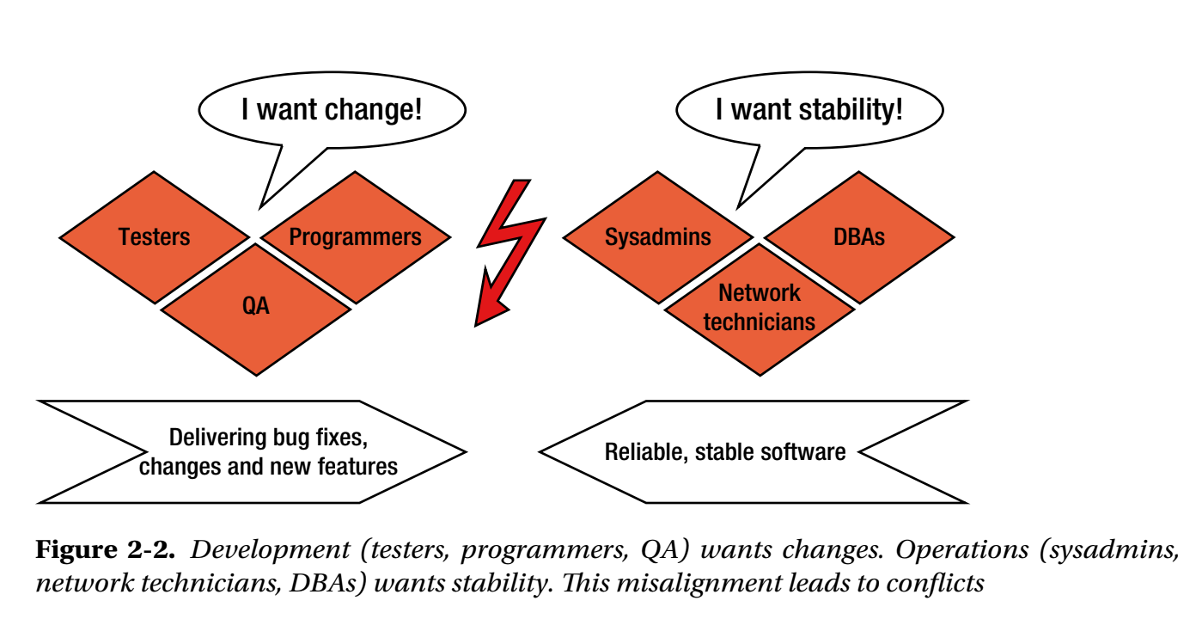

Slide 29
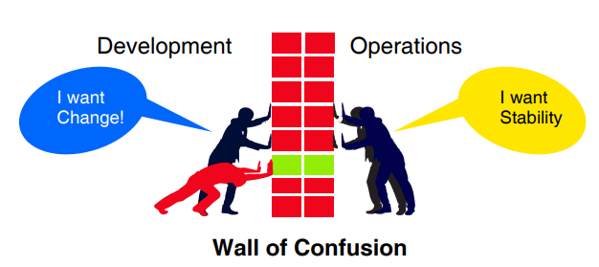

Slide 30






Software Lifecycle Env.
Developer
Tester
Customers
Op. Admin / DBA
View
View
App Server
App Server
App Server
App Server
Development Environment
Testing Environment
Staging Environment
Production Environment
DB

Slide 31
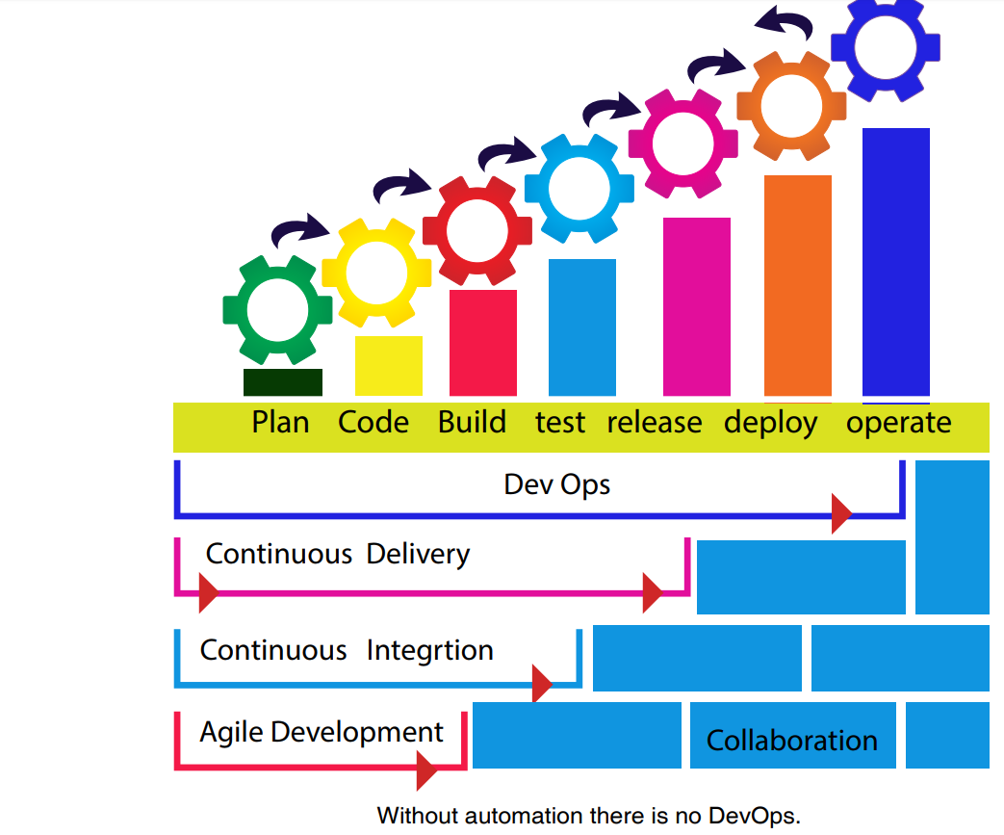

Slide 32
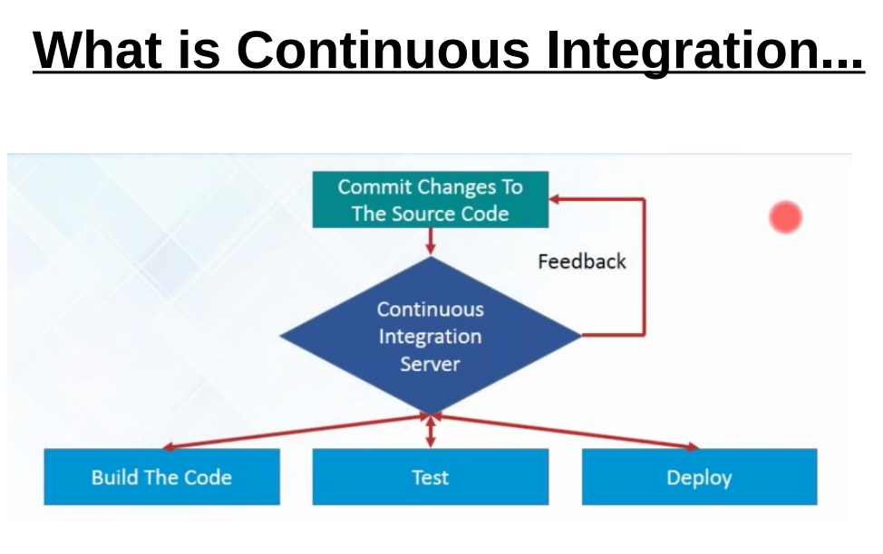


Slide 33
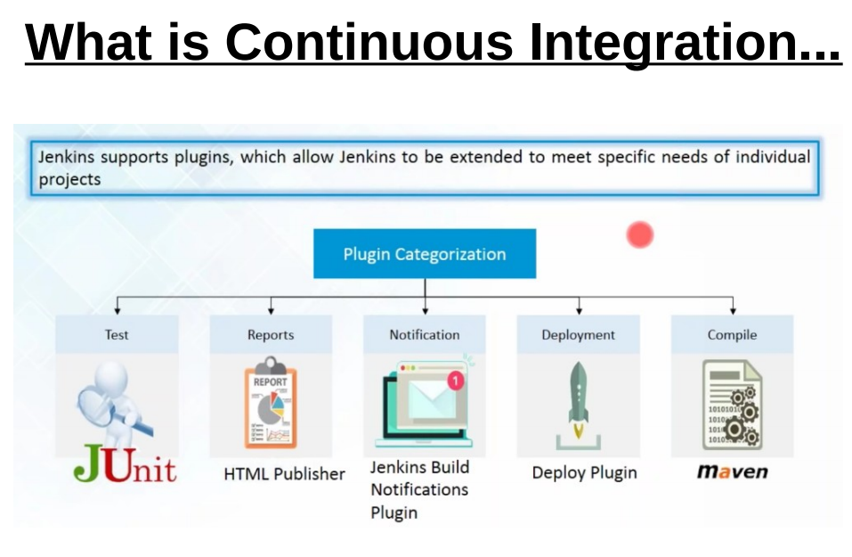

Slide 34
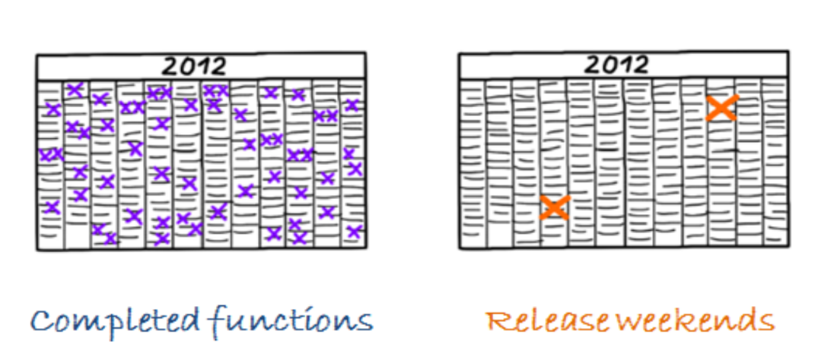

Slide 35
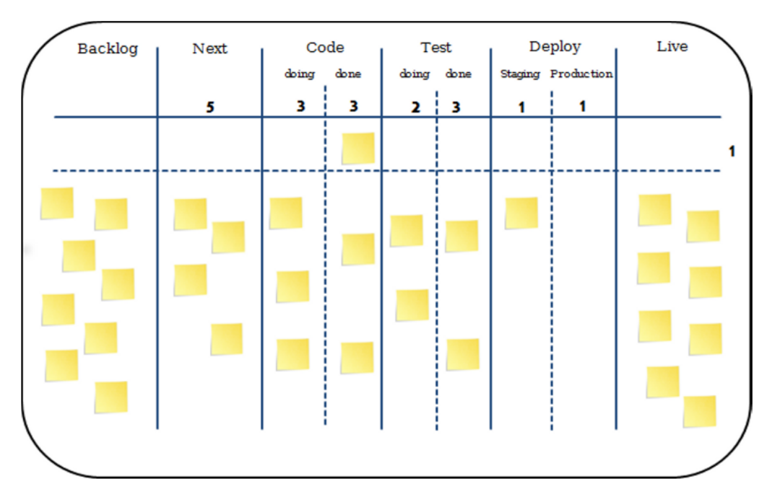
Kanban Board for DevOps

